Slide 1
The Institute of Chartered Accountants of India (Set up by an Act of Parliament)
Women & Young Members Excellence Committee
Organises
Sky High Symposium-85
CA. Priti Paras Savla
Chairperson, WYMEC, ICAI
CA. Abhay Chhajed
Vice Chairman, WYMEC, ICAI

Slide 2
The Institute of Chartered Accountants of India (Set up by an Act of Parliament)
Audit and documentation - SMEs
22.12.2023

Slide 3
AUDIT OF SMEs
Many publications of ICAI
Practitioner’s Guide to Audit of Small Entities (Revised 2020)
Recent one - Audit Working Paper Templates (June 2023)
Highly useful for mid and small size firms
Ready reference for audit team
Very handy and useful to maintain documentation
Helps in Peer review process

Slide 4
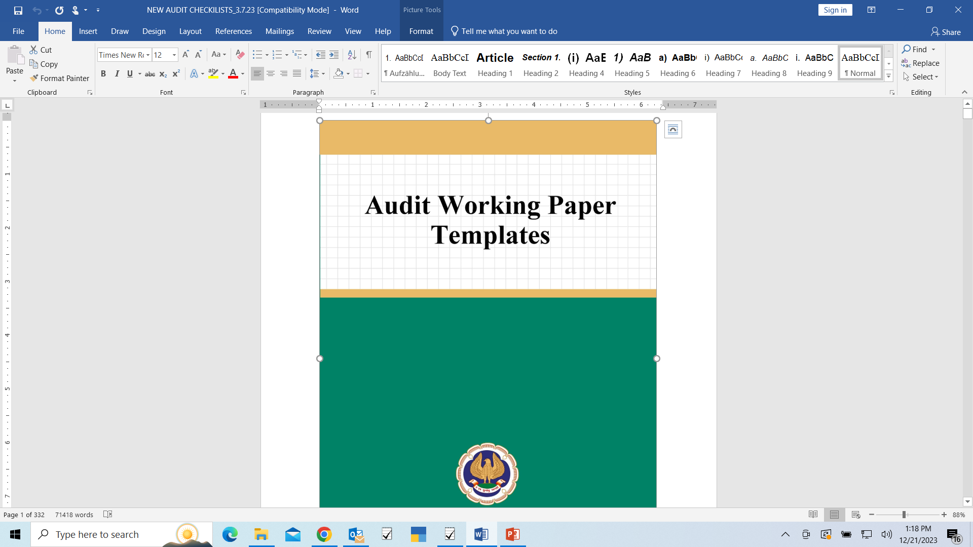

Slide 5
Appointment
Engagement acceptance
Engagement letter – (drafts available)
Independence Confirmation
Confidentiality undertakings
Client engagement acceptance checklist

Slide 6
Chapter 1 - Appointment
Draft format of Engagement letter
To,
The Board of Directors of …………… (name of the Entity)
(Address)
Dear Sirs,
I / We refer to the letter dated informing me / us about my / our (re) appointment as the auditors of the Company. You have requested that I / we audit the financial statements of the Company as defined in Section 2(40) of the Companies Act, 2013 (‘Act’), for the financial year(s) beginning April 1, 2xx2 and ending March 31, 2xx3. The financial statements of the Company include, where applicable, consolidated financial statements of the Company and of all its subsidiaries, associate companies and joint ventures. I am / We are pleased to confirm my / our acceptance and my / our understanding of this audit engagement by means of this letter.
My / Our audit will be conducted with the objective of me / our expressing an opinion if the aforesaid financial statements give the information required by the Act in the manner so required, and give a true and fair view in conformity with the applicable accounting principles generally accepted in India, of the state of affairs of the Company as at 31st March, 2xx3, and its profit/loss and its cash flows for the year ended on that date which, inter alia, includes reporting in conjunction whether the Company has an adequate internal financial controls system over financial reporting in place and the operating effectiveness of such controls. In forming my / our opinion on the financial statements, I / we will rely

Slide 7
Chapter 1 – Client engagement Acceptance checklist

Slide 8
Chapter 1 – Independence declaration
(Following draft may be used)
Confirmation of Compliance with Ethical Requirements and Independence by partners / key staff members
ABC & Associates LLP
Chartered Accountants
Attention: Mr. AA (Partner)
As mentioned in your communication to us, I, the undersigned, have noted that ABC & Associates LLP have been appointed to perform statutory audit of the financial statements of XYZ Company Pvt Ltd for the year ended March 31, 2xx3.
In this regard, I confirm that I am in compliance with the ethical requirements, including applicable independence rules with respect to XYZ Company Pvt Ltd and all of its related entities as follows:
I am independent in accordance with the independence requirements of ABC & Associates LLP, the Standards on Auditing in India and the Companies Act, 2013.
I am not aware of any past or existing professional services, business arrangements or alliances between me and the entities indicated on the attached listing that would impair independence.
I hereby confirm that-
None of my relative or myself is holding any security of or interest in XYZ Company Pvt Ltd and its related entities that would impair independence.
None of my relative or myself is indebted to XYZ Company Pvt Ltd and its related entities, for an amount exceeding Rs. 5 lakh or has given any guarantee or security in connection with the indebtedness of any third person for any amount exceeding Rs. 1 lakh.
None of my relative is a director or is in the employment of XYZ Company Pvt Ltd as director or as key managerial personnel.
[Signature]

Slide 9
Planning audit
Scope of engagement – Audit planning memorandum (KYC )
Minutes of Planning meeting – Preliminary discussion, discussion about entity, Agenda for next meeting, Closing Note
Note on Basis of Materiality
Preliminary Analytical Review
Audit team, role assignment, timelines of Audit activities
Internal audit checklist
Initial Audit checklist
Communication of Audit Schedule

Slide 10
Chapter 2 – Audit planning

Slide 11
Chapter 2 – Note on Materiality
 |  |  |  |  | (Amount in Millions)
S. No. | Particulars | Amount | % Consider-ed | Overall materi-ality | Planning materi-ality | % Consider-ed | Perfor-mance Materiality
1 | On the basis of Revenue (net)
2 | On the basis of Assets (Property, Plant and Equipment)
3 | On the basis of Profit before Tax
4 | Clearly Trivial Threshold (Refer Note given below)
Materiality Considered: On the basis of Revenue -
Overall Materiality
Planning Materiality
Performance Materiality

Slide 12
Chapter 2 – Preliminary Analytical Review

Slide 13
Chapter 2 – Audit team

Slide 14
Chapter 2 – Audit Schedule

Slide 15
Risk Analysis
Significant Risks and Planned Procedures headwise
Fraud risk (if any)
Testing Stategy – BS and PL
Variance Analysis – BS and PL

Slide 16
Chapter 3 – Significant Risks & Planned procedures

Slide 17
Chapter 3 – Fraud Risk

Slide 18
Chapter 3 – Testing Strategy- BS and PL

Slide 19
Chapter 3 – Variance Analysis – BS & PL

Slide 20
Audit procedures (Financial Statements) - Execution
Audit testing checklist with responsibilities noted
Headwise control chart – having procedures and actual observation
Examples – Debtors (ECL to be obtained), Trade Payables (List to b obtained, balance confirmations to be obtained, etc)
Final Remarks – significant pbservations will go to Audit Summary Memorandum

Slide 21
Chapter 4 – Work Allocation noted

Slide 22
Chapter 4 – Control chart headwise – BS and PL

Slide 23
Chapter 4 – Control chart headwise – BS and PL

Slide 24
Other Audit procedures
Going Concern – net worth negative?, Key financial ratios, operating or cash losses?, payments regular, etc…
Subsequent events review
Internal Controls over Financial Reporting
Related Party Transactions
Contingent liabilities
Use of Work of Experts
Secretarial Compliances
Work of Internal Auditors

Slide 25
Financial Reporting
Accounting Policies
Notes to Accounts and disclosures
Schedule III checklist
CARO checklist

Slide 26
Audit Completion
Audit Report and Financial Statements
Audit issues and Closure (ASM)
Engagement Quality Control Review
Management Representation Letter
Final Analytical
Communication with Audit Committee
Partner Review documents
Closure
Procedures for Client’s Documents

Slide 27
Chapter 7 – Audit Summary Memorandum
Audit Memo for the year ended March 31, 2xx3
S. No | Query/ Issue Description |  |  |  | Disposal by Audit Team |  |  |  |  | Status
 | Caption/ Area | Particulars | Require-ments from Manag-ement | Manage-ment Respo-nse | Auditor's response |  | Significant matters |  | Proce-dure perfor-med

Slide 28
Chapter 7 – Management Representation Letter

Slide 29
Chapter 7 – Final Analytical Review

Slide 30
Chapter 7 – Procedure for Client’s documents
Every working paper provided by the client goes through basic 3 level checks before any work is started on the same.
Domain – The domain from which the email is received and the portal i.e., through which data has been provided from the client belongs to the client.
Sender – Whether the person sending the data from the client side is authorized to do so in their capacity. This can be traced by the understanding of the hierarchy from the client.
Arithmetical accuracy –After receipt of data from the client, we check the arithmetical accuracy of the sheet provided to us by recalculation of the formulas in the sheet and derive if the result obtained is matching the data provided by the client.
Cross Tally – The data provided is cross verified with the trail balance or financials if the data provided is of such nature which can be directly matched with the books.
Sanity – The sanity of data provided by the client is not disturbed. After receipt of data the client data is saved “as it is” and another copy of the workbook is prepared and whatsoever working required is performed on the copy version prepared.
Attestation –If the data is provided in paper format, then we assure the same must be attested by the competent person to provide the data.
Other Documents – For other documentation such as bank statements, loan agreements, Articles of Association or Memorandum of Association etc., we ensure that the same are attested by the competent authority or is provided in the proper format as it should be. It is being ensured that external confirmation to be obtained rather than relying on the client.

Slide 31
Question and Answe﻿r...

Slide 32
Thank You
Women & Young Members Excellence Committee
011-30110573
wmec@icai.in
www.wmec.icai.org
ICAI Bhawan,
3rd Floor, Annexe Building
Indraprastha Marg, New Delhi

